Slide 1

Analysing “why” people participate in hackathons
G2T2
Yeo Yao Cong
Darien Tan
Kershawn Liau
Andy Pee
Ong Zhi Yi
Notes:
Good evening everyone! My group consisting of yao cong, kershawn, andy, zhi yi and myself will be presenting to you on our project proposal with DELL technologies.
As hackathons are taking into storm today, we would be analyzing on why people would like to participant in such events.

Slide 2
Table of contents
01
02
03
About DELL
Intrinsic Motivation
Trending Topics
04
05
06
Extending Engagement
Architecture Diagram
Project Management
07
08
Timeline
Conclusion
Notes:
These are the table of contents we would be going through.
Firstly, we will have a brief description of dell, followed by the 3 categories we have split into : Intrinsic Motivation, trending topics and extending engagement.
Next, the architecture diagram, project management, our timeline we have planned out and lastly the conclusion.

Slide 3
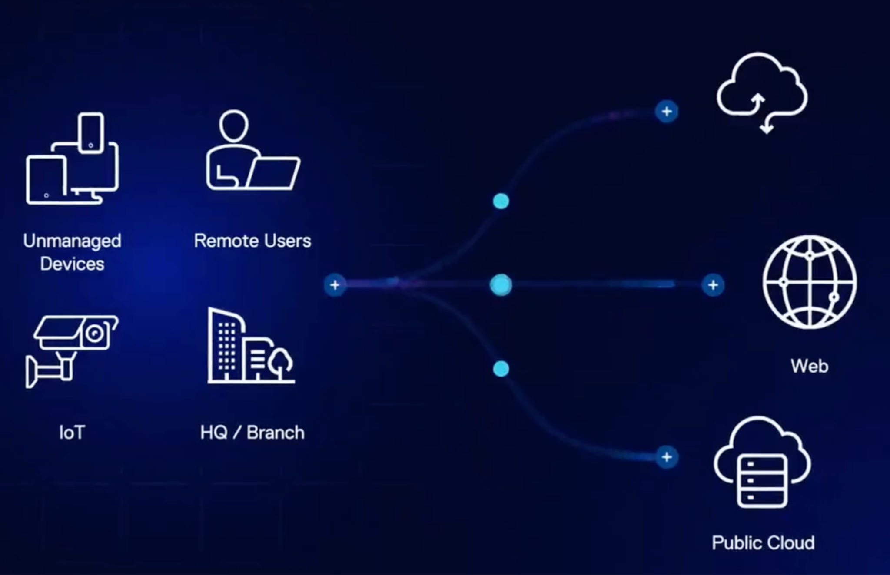
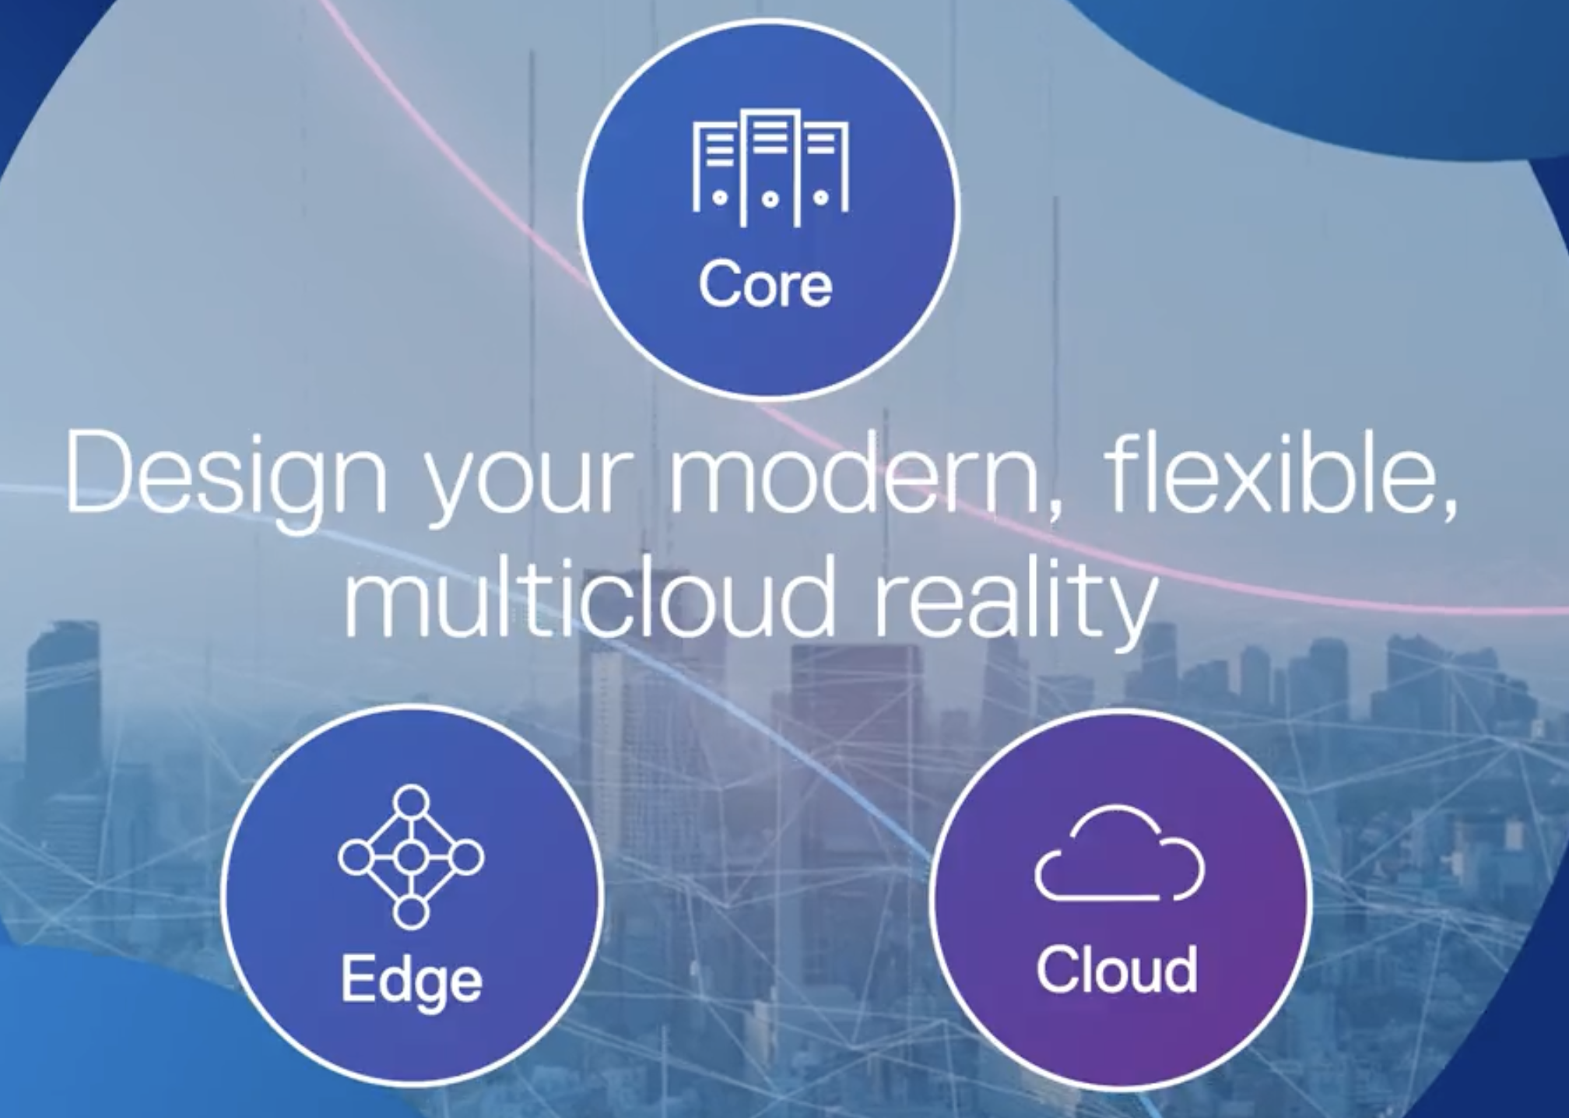
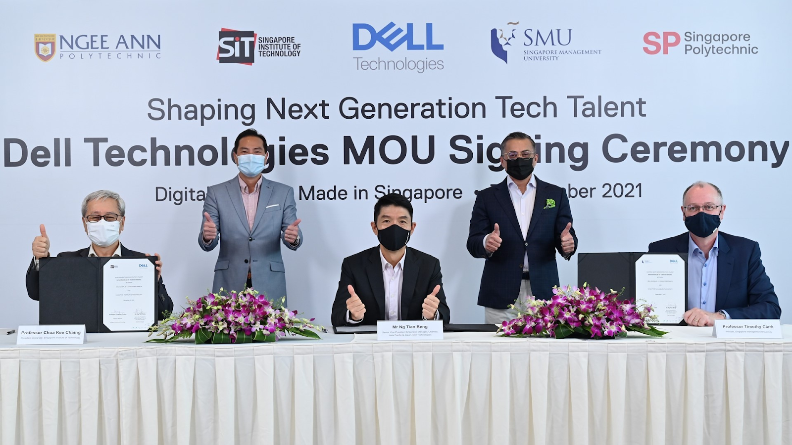
Overview
Requirements
Datasets
Solution
Conclusion
One of the largest Tech Companies in the world
Bread and Butter for Tech Giants like Amazon, Google, VMWare, AMD, Intel
Founded by Michael Dell in 1984
Driven by ambition and power of technology to drive human progress
Notes:
So firstly, i would be going through a short introduction of DELL Technologies.
Dell is an American technology company that develops, sells, repairs, and supports computers and related products and services. Dell was once a pure hardware vendor and has now expanded its business, offering various services such as data storage, information security, virtualization, analytics, and cloud computing.

Slide 4


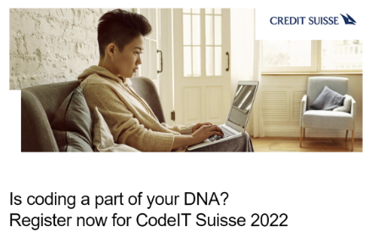

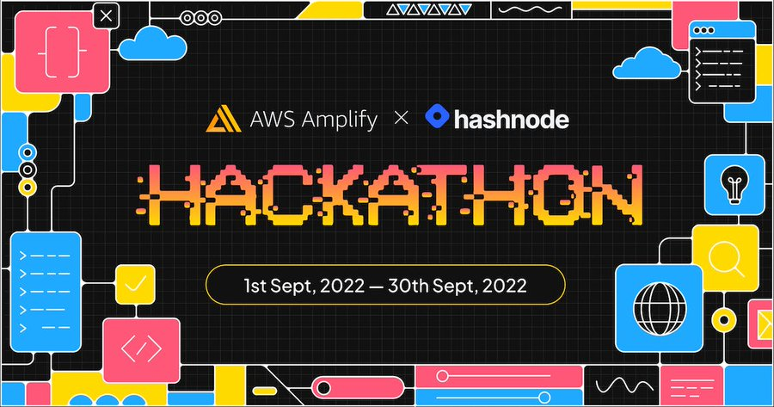

How can we better plan our future hackathons?
Overview
Requirements
Datasets
Solution
Conclusion
2022 Hackathons hosted by Dell Technologies
Hackathons hosted by other organisations
Notes:
With the increasing demand towards hackathons, becoming a common place for companies to crowdsource ideas and reduce recruitment hiring process, Dell is not left out either as they seek for individuals who are passionate and talented thinkers. Popular hackathons hosted by other organisations includes code for good by JP Morgan or even HACK2HIRE by DBS
However, a virtual hackathon (Lifesavers’ Innovation Challenge) hosted in Quarter 2 2022 by Dell, has a significantly lower turnup rate compared to its sign up rate. Hence, Dell could be concerned that this may be the same case for future hackathons as they also hosts other hackathons such as Hacktrick

Slide 5

Overview
Requirements
Datasets
Solution
Conclusion
Requirements from Dell Technologies
SCDF Comments
“The quality of the participants this year has drastically decreased compared to 2021”
How can we improve our future hackathons?
Data Points
Intrinsic Motivations of the participants
Extend Engagement with Participants
Trending Topics (TechStack) for Hackathons
Notes:
So dell is requiring us to seek data to potentially improve their future hackathons. Their objective is to utilise the information and insights gained through social analytics frameworks to better understand and plan future events.
To tackle the problem, we have decided to categorise them into 3 categories:
Intrinsic Motivation
Extend engagement with participants
AND Common interesting hackathon topics
So now i will pass my time to andy who would be sharing more about the Intrinsic Motivation

Slide 6



Intrinsic Motivation
Overview
Requirements
Datasets
Solution
Conclusion
Sentiments Analysis
Forums (HardwareZone, Reddit, etc)
News (StraitsTimes, CNA, Businesstimes)
With the Data
- Feature Extraction
- Sentiment-labelled Training
- Generate Overall Sentiment
Competitor Analysis
Sentiment Analysis will also be conducted on Dell’s competitors.
They include:
DSTA
Google
JPMorgan
Hua Wei
Shopee
Notes:
So for intrinsic motivation, we will conduct Sentiment analysis on Dell’s past hackathons to study the attitudes, emotions or opinions of the participants towards the hackathons.
This is how the process will look like.
Firstly, we will scrape data from forums or social media. We will mainly be focusing on retrieving comments of Dell’s past hackathons rewards to check if it is beneficial to the audiences.
Next, it will be Feature Extraction whereby we will conduct tokenization, stopword removal, transform text into numbers using Word2vec algorithm
Subsequently, we will feed a sentiment-labelled training set to the machine learning algorithm
Lastly, we will feed scraped data into the algorithm to generate overall sentiment for the data.
Subsequently, similar sentiment analysis can also be conducted on the competitors. Competitor analysis will be conducted on the competitors with positive sentiments to understand what the competitors are offering.

Slide 7
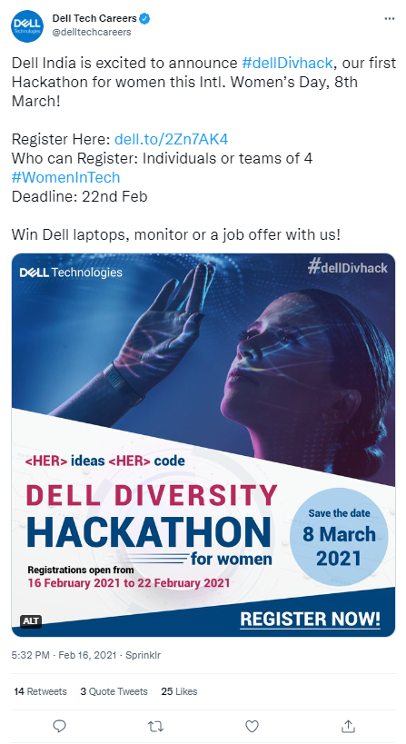
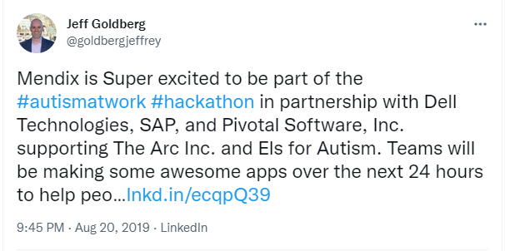
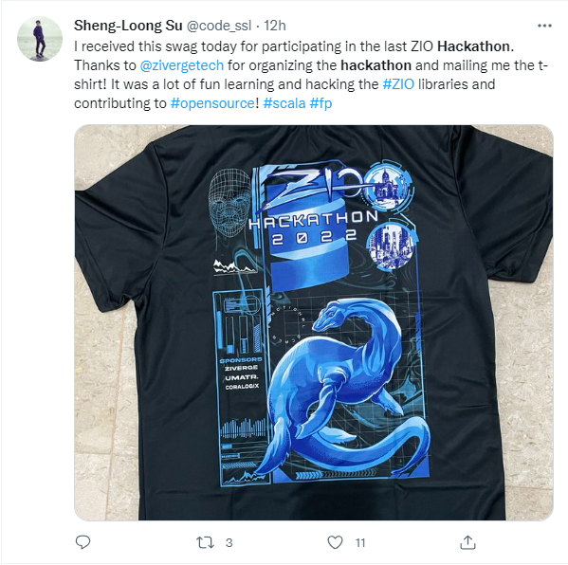
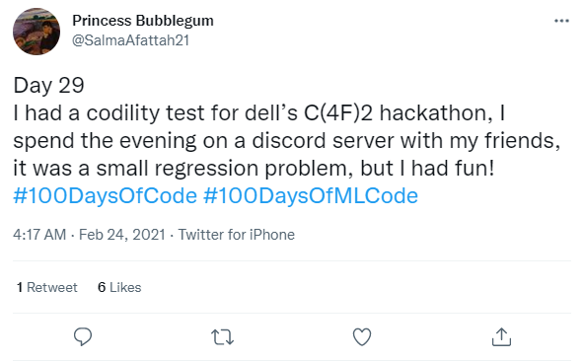
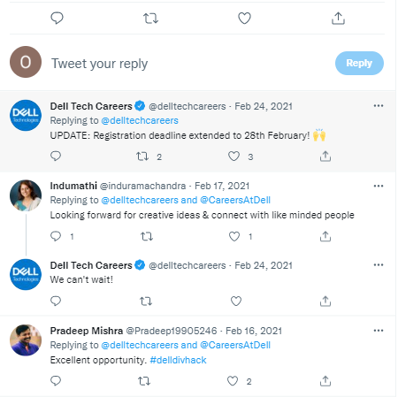
Examples of Analysis of
Intrinsic Motivation
Overview
Requirements
Datasets
Solution
Conclusion
Notes:
These are the examples of analysis of intrinsic motivation. We will be retrieving keywords that identify emotions and attitudes towards a hackathon. Those words highlighted in the red circles are keywords that we are looking for and to be fed to machine learning algorithm to generate the overall sentiment.

Slide 8
Trending Topics (TechStacks) for Hackathons
Overview
Requirements
Datasets
Solution
Conclusion
Hardware Zone
Reddit
With the data:
Extract topics into two textual corpora
Normalization, Noun Phrase extraction, Refinement and scoring of corpora
Train W2V model for clustering
Compare and analyze topic lists generated
Generate automatic report for extracted topics, “Hot” and “Cold” trends and topic clustering in 2D space
Topic Analysis
Trend Analysis
Notes:
So for trending topics for hackathon. we will be obtaining common hackathon topics across the years by scraping multiple websites (Hardware zone, Reddit etc.) and conduct topic modelling to group them into clusters. Once this is complete, we will use the generated dataset from the previous step for trend analysis to get the gist of the popular hackathon topics across the years in attempt to predict the uprising trends.
This is how the process will look like. Firstly, we will attempt to extract topics into two textual corpora. Text corpora is a language resource consisting of a large and structured set of texts. In this case, we will have one defined as the target corpus (current trend) and and reference corpus (last month trend).
Once we have both corpora, we will be running the two corpora through the Topic Extraction pipeline: Normalization -> Noun Phrase extraction -> Refinement -> Scoring. In this stage, the algorithm will also train a W2V model on the joint corpora to be used for the clustering report (this step can be skipped). In the second stage the topic lists are being compared and analyzed. Finally the UI reads the analysis data and generates automatic reports for extracted topics, “Hot” and “Cold” trends, and topic clustering in 2D space.

Slide 9
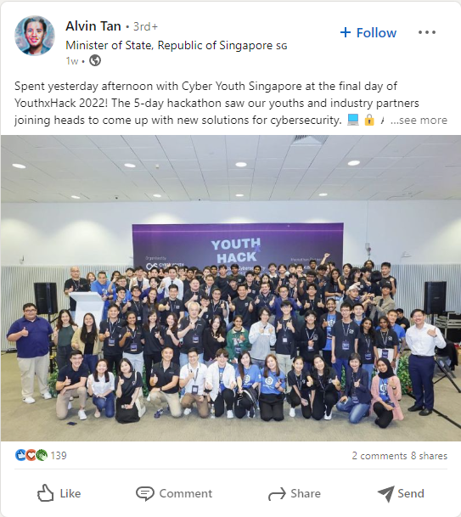
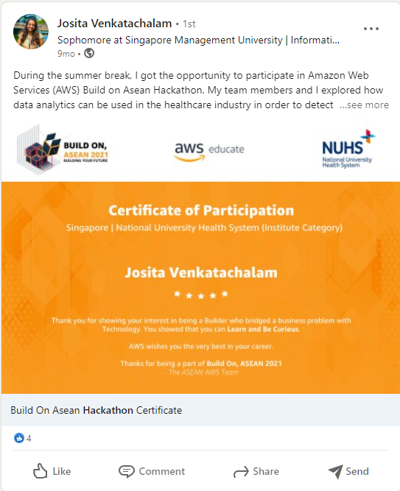
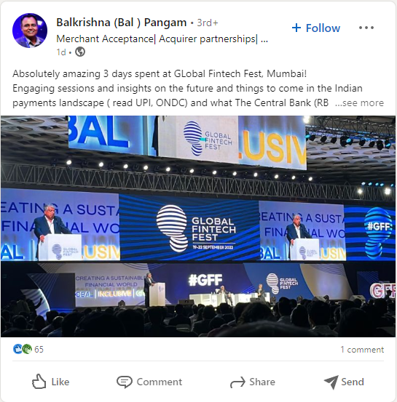
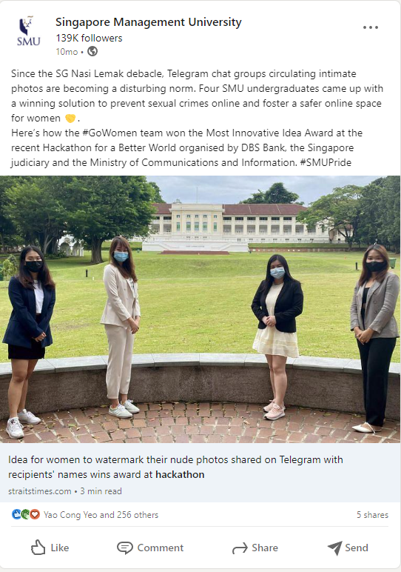
Example of Analysis of
Trending Topics
Overview
Requirements
Datasets
Solution
Conclusion
Notes:
These are the examples of analysis of Trending Topics . We will be retrieving keywords that identify the topics of a hackathon through the winners or participants post on social media. This allows us to retrieve information on what makes a successful team and hackathon

Slide 10

Extend Engagement with Participants
Overview
Requirements
Datasets
Solution
Conclusion
Network Analysis
Twitter
With the Data
Use data to make a network graph
Create visualisation to see the most ‘influential’ nodes
Find followers with High betweenness centrality and in-degree centrality
Competitor Analysis
Engagement rate of Dell and competitors
They include:
DSTA
Google
JPMorgan
Hua Wei
Shopee
Notes:
Thank you Andy, now I will be going through how we plan to help Dell extend engagement with their participants.
We plan to conduct Network Analysis on Dell’s twitter account to identify influential users who may extend Dell’s engagement outreach and facilitate information flow. We will use a crawler to collect all followers of Dell Technologies by traversing through their “following” relationships. We will also be scraping Dell Technologies’s most retweeted post to find out which followers retweeted and if the follower’s followers also retweeted and so on. This will also be represented in a network graph and if user A retweeted user B, there will be an edge connecting them together. With this data, we can find out the betweenness centrality of the followers as well as the in-degree of these followers (high in-degree centrality means they are social influencers who are frequently retweeted). Dell technologies should than ensure these followers are incentivized or motivated to continue follow their social media and retweet their post.
Also,To better understand how Dell is standing against its competitors, we will conduct competitor analysis to understand how well its competitors are engaging with their hackathon participants.We will be scraping different engagement counts of Dell and its competitors to compare their engagement rate.

Slide 11
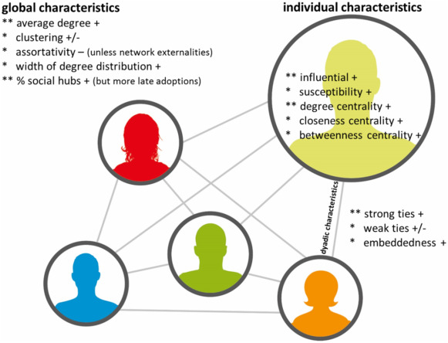
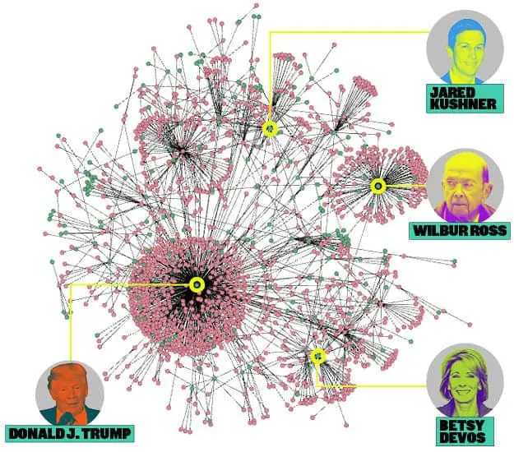
Example of Analysis for
Extending Engagement
Overview
Requirements
Datasets
Solution
Conclusion
Notes:
An example of Network Analysis for extending engagement is to work with 3 main metrics taught in class.
First, the degree of centrality. It is used for finding very connected individuals, popular individuals, individuals who are likely to hold most information or individuals who can quickly connect with the wider network. Examples of People with great influence are like Donald Trump, Jared Kushner and etc.
Next, we want to find the closeness centrality which is finding the individuals who are best placed to influence the entire network most quickly. Closeness centrality can help find good ‘broadcasters’, but in a highly-connected network, we will often find all nodes having a similar score. What may be more useful is using Closeness to find influencers in a single cluster. So how we approach this is to identify multiple (single type) clusters, which we can then identify the broadcasters of each single clusters. For example, if Institutes of Higher Learning like SMU follows a Dell Events Page. Every hackathon news will go through the SMU’s social media to reach to the students, hence SMU is a “broadcaster” in this case.
Lastly, We want to work with betweenness centrality to find the individuals who influence the flow around a system. Betweenness is useful for analyzing communication dynamics, but should be used with care. A high betweenness count could indicate someone holds authority over disparate clusters in a network, or just that they are on the periphery of both clusters. This allows us to link the multiple (single-type) clusters together. Entities such as professors who works closely with Dell, are the links whom can link to multiple other institutions due to their network strength.

Slide 12
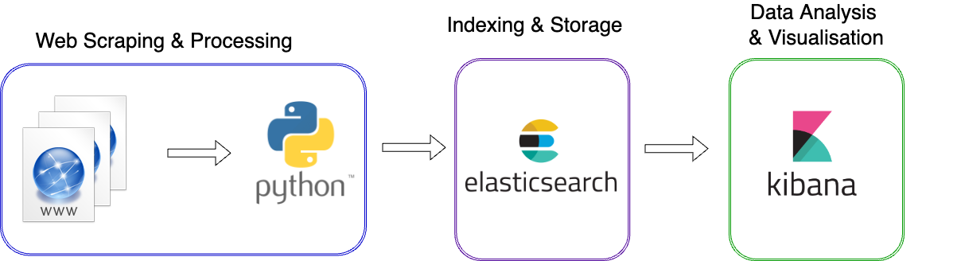
Architecture Diagram
Overview
Requirements
Datasets
Solution
Conclusion
Notes:
The following diagram illustrates our Architecture Diagram, where we scrape data mainly using python and its libraries from the internet. We will also process the data within the python scripts itself before ingesting all data to elasticsearch and displaying visually on Kibana.

Slide 13
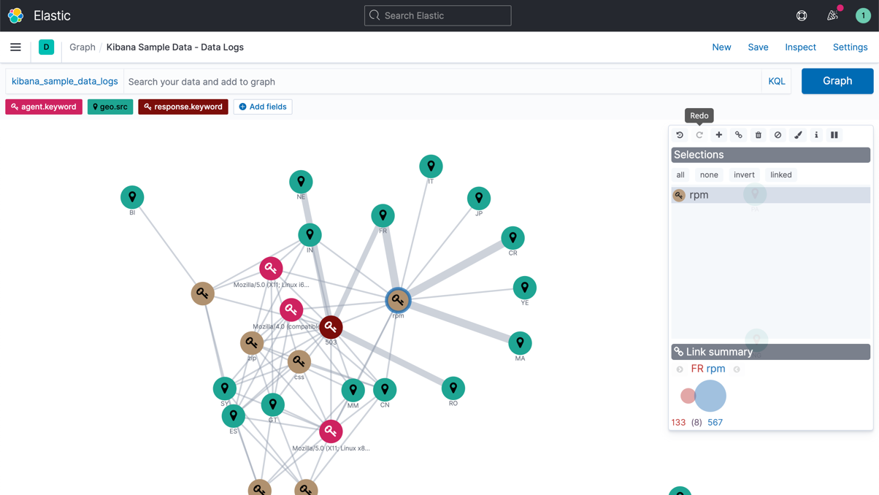
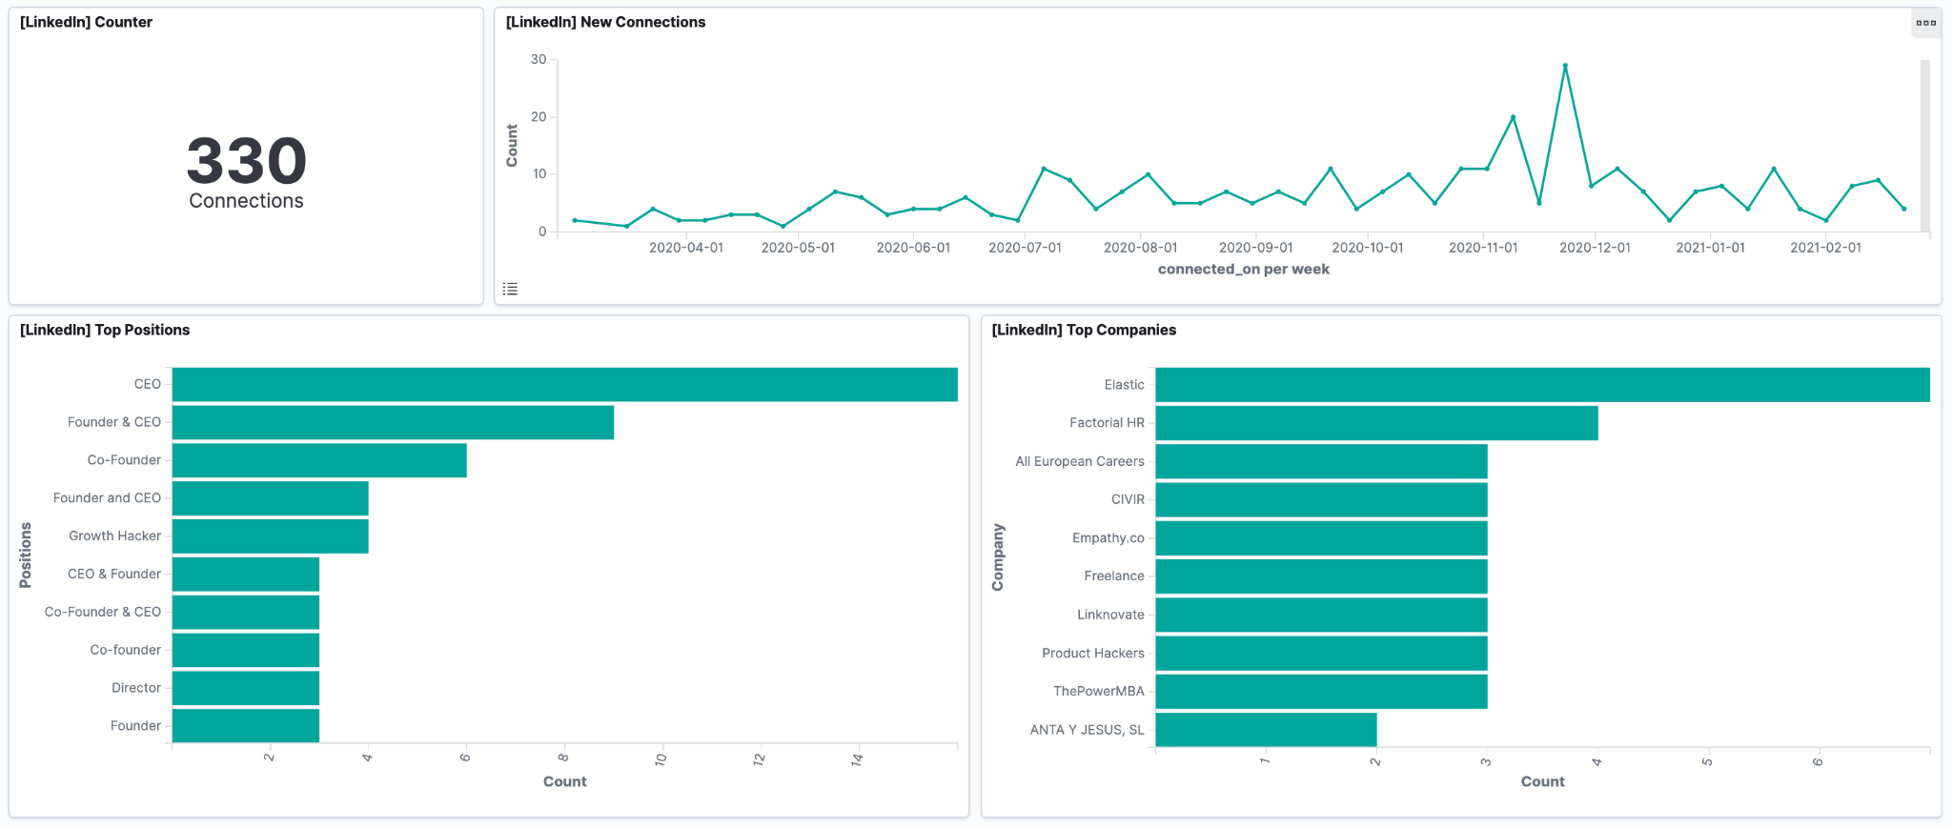
Examples
Overview
Requirements
Datasets
Solution
Conclusion
Notes:
Kibana is a source-available data visualization dashboard software for Elasticsearch, which is free and it offers a vast variety of data visualizations formats

Slide 14
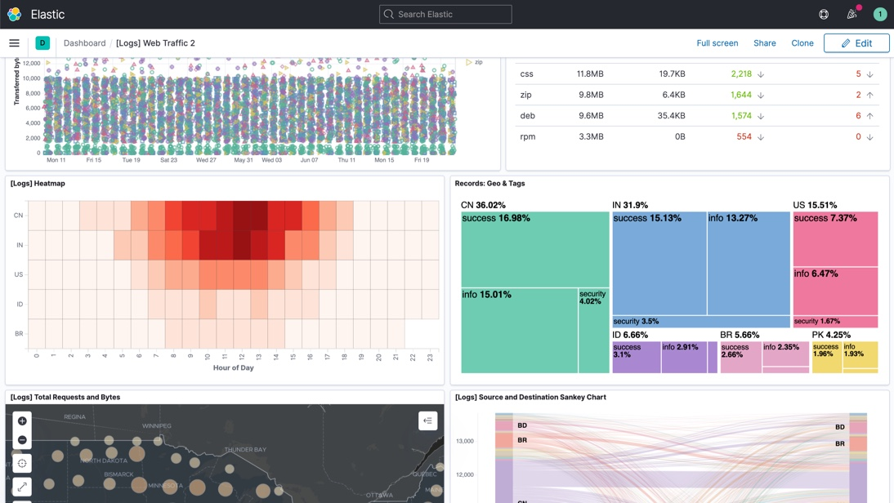
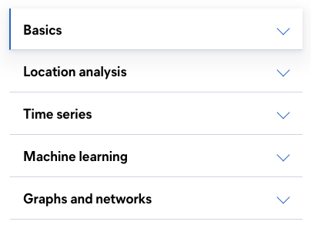
Kibana
Overview
Requirements
Datasets
Solution
Conclusion
Notes:
This ranges from examples such as histograms, line graphs, pie charts, sunbursts to location analysis, time series, ML and most importantly graphs and networks which we have been thought in week 5 and 6 of social analytics.

Slide 15

Project Management
Overview
Requirements
Datasets
Solution
Conclusion
How we Work
Agile Sprint Framework
A sprint is a short, time-boxed period when a team works to complete a set amount of work.
Using Trello to keep track of tasks and personal deadlines
Notes:
We will be using an agile scrum methodology where we will work based on story points which we estimated at the start of each sprint. Each task allocation has its own estimation and story points which we have came together as a group and discuss our commitment to ensure all our vision and tasks are aligned. We decided to use Agile Scrum as It will help the team to focus on the current sprint objectives. For example, Sprint 1 we will obtain all the data using web scraping techniques and Sprint 2 we will be displaying the data on Kibana via elasticsearch for visualisations.

Slide 16




Project Management
Overview
Requirements
Datasets
Solution
Conclusion
Github
Github Desktop
Notes:
Our Project Management and Timeline will involve the usage of Git version control, utilised by github desktop installed on our machines to ensure that we are able to work independently and effectively while using github as our repository. Lastly, we will track each outstanding tasks individually via a Trello board which ensures all our tasks are completed by the end of Week 13. A snipshot of our Trello board will be shown shortly!

Slide 17
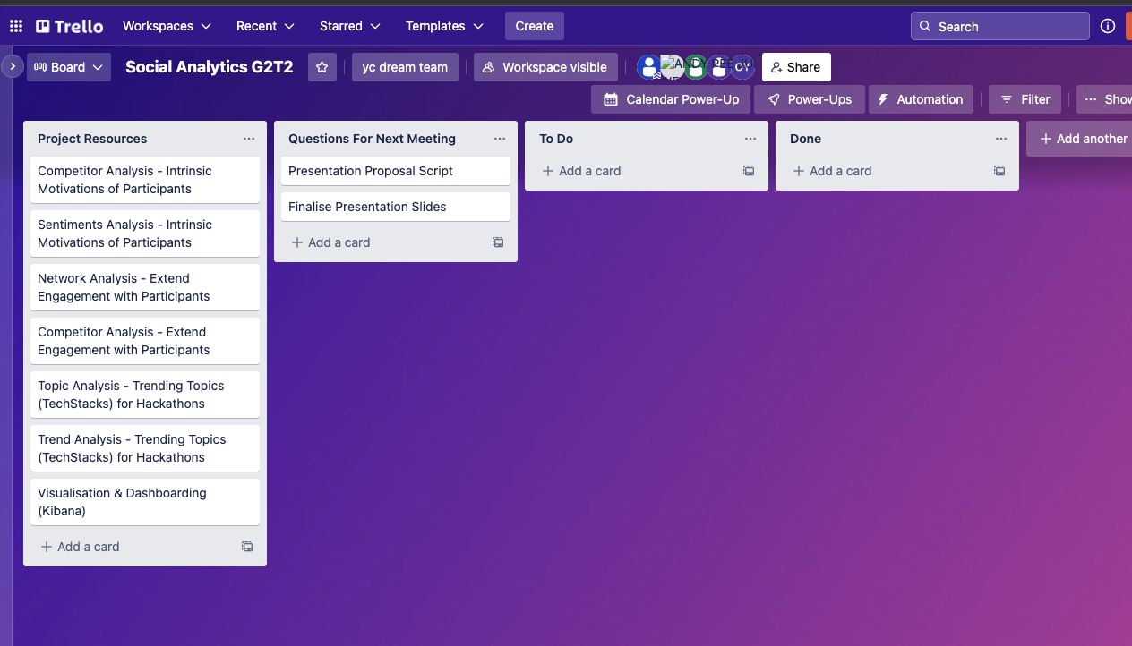
Project Management
Overview
Requirements
Datasets
Solution
Conclusion
Notes:
Trello will be our main way of managing our project. We would create cards/tasks that we need to do in each sprint and we will assign them to various people. This will keep our project organized and reduce any chances of work being duplicated. We would also hold meetings after every sprint, to gather up thoughts and questions. We would then communicate these questions to our sponsor/Dell, to let them know of our current progress and to clarify and questions. Yao cong will be the main point of contact between Dell and the team, and we would communicate through email.

Slide 18
Project Management
Overview
Requirements
Datasets
Solution
Conclusion
Task Allocation
Member | Duties
Yao Cong | Team Lead, Liaison with Dell Technologies, Poster, Final Report
Andy | Web Scraping, Final Report
Darien | Competitor analysis, Final Report
Kershawn | Topic and Trend analysis, Final Report
Zhi Yi | Analysis of insights to generate recommendations, Final Report
Notes:
These are the tasks allocation that we arrived at right now, and it might be subject to further changes which hence we adopted the Agile Scrum methodology to ensure that everyone takes ownership of the project, and not just their individual assigned tasks.

Slide 19
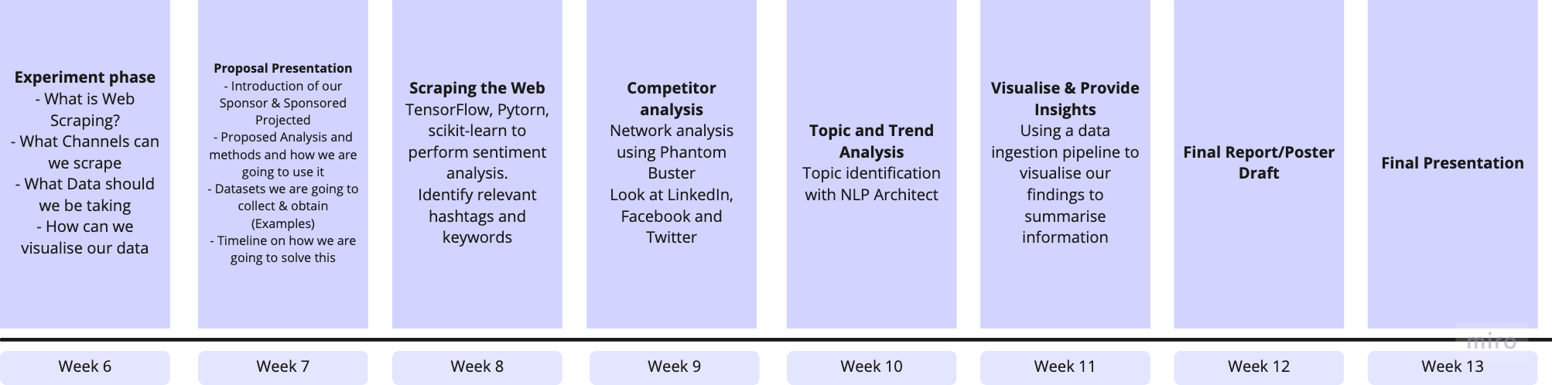
Timeline
Overview
Requirements
Datasets
Solution
Conclusion
Notes:
This is our proposed timeline for our project. Our team has actually started doing preliminary research on what webscraping is and what sort of libraries we should use. We have covered that in the earlier slides already. This week is week 7 and we are doing the presentation today. So for week 8, we would start doing the scraping, using tools like tensorflow, python and scikit-learn to do sentiment analysis and identify relevant hashtags and keywords. For week 9, we will be looking at competitor analysis. We will analyse competitors, competitors being companies that also hold hackathons. With these data collect, we would do a topic and trend analysis. On week 11, we will visualise our data, and provide insights to our sponsor. Week 12 would be preparing the final report and poster draft. Week 13 would be our final presentation. We would complete both report and poster after the presentation and prepare for submission.

Slide 20
Conclusion
Overview
Requirements
Datasets
Solution
Conclusion
Expected Learning Outcomes
Aid our sponsor by providing insights and valuable summary on a visibly informative dashboard
Customer-centric approach (Working with Customer’s requirements)
Web-Scraping & Social Analytics Frameworks
Data Ingestion Pipeline & Visualization using ELK Stack / Visualisation Tools
Notes:
In summary, we want to aid dell, by providing them with a dashboard that can summarise our insights. We would also learn about a customer centric approach, which is understanding our customer’s requirements clearly, and delivering what they request. We would also leave this course with social analytics frameworks and also webscraping skills. As a bonus, our team will walk away with visualisation skills as well as understanding of the ELK stack.

Slide 21
Overview
Requirements
Datasets
Solution
Conclusion
Questions & Answers
Thank you very much for listening to our presentation
By: G2T2
Yeo Yao Cong
Darien Tan
Kershawn Liau
Andy Pee
Ong Zhi Yi
Notes:
We have come to the end of our presentation and we will take questions now.

